Slide 1
Opportunity to Build School and Home Relationships
Engagement Tip!
Have you noticed all the photos are from Pinellas County Title I schools?
Replace them with pictures that represent your school community.
Notes:
Delete this slide prior to your meeting.
EVIDENCE: Take photos at the events and use as part of the evidence to support meeting.

Slide 2
Tips and Recommendations before you get started
Cross-Coordination: Consider how you can use other federal funds (Title III, IDEA, Business/Community) to maximize your event.
Grade Level Target: Consider implementing meeting in a smaller group, such as subject or grade level.
Presentation Key: - Optional; - Required

Slide 3

Title I Annual Parent Meeting
Insert school logo here
Insert School’s Name
Insert Date
Insert Time
Insert Location of Meeting
Insert Principal’s Name
Notes:
Evidence: Upload completed presentation and recorded feedback as part of the evidence to support the Annual Meeting Materials. Do not forget the sign-in sheets, and survey/feedback that you receive throughout the meeting.

Slide 4

Education, then, beyond all other divides of human origin, is a great equalizer of conditions of men.”
– Horace Mann
Notes:
“Education, then, beyond all other divides of human origin, is a great equalizer of conditions of men.” – Horace Mann

Slide 5
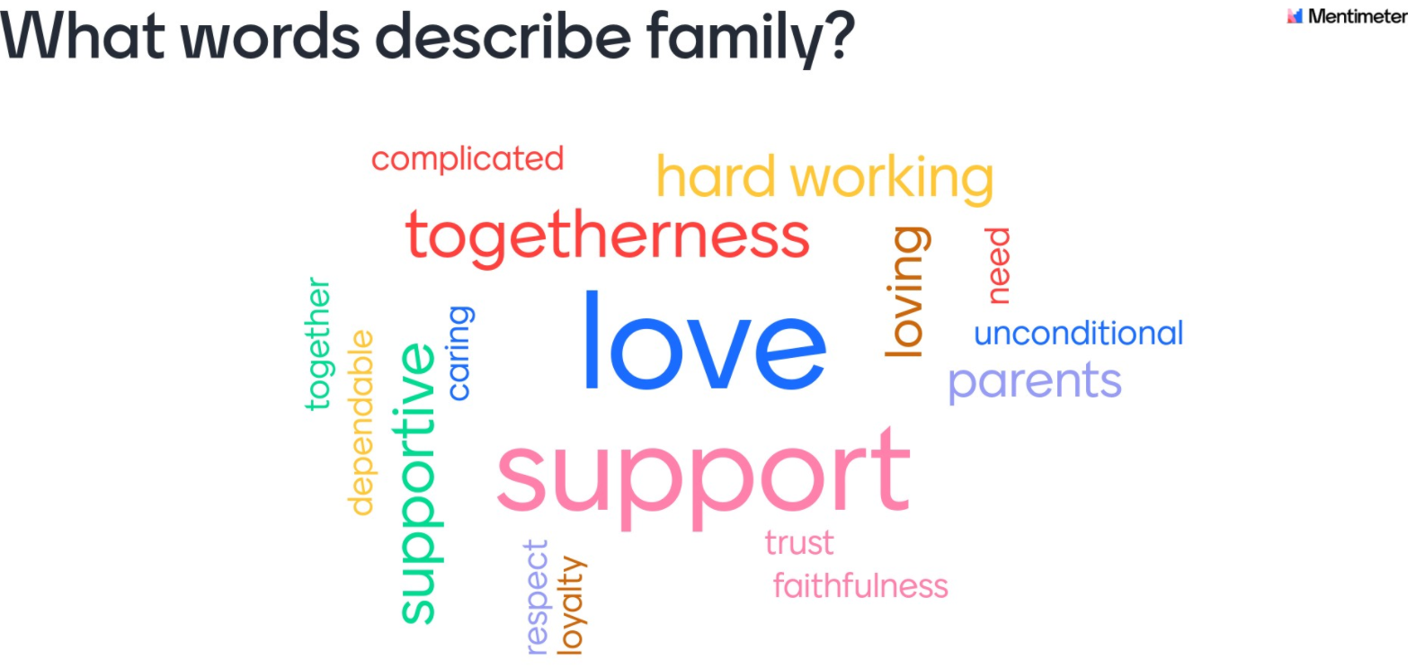
Opportunity to Build School and Home Relationships
Engagement Tip!
Get to know your families by inserting a get to know you and your child icebreaker activity.
Snip and paste a QR code for convenience.
*Check out Mentimeter.com*
Notes:
Insert icebreaker or a “get to know you/your family” activity here! Use the icebreaker to take attendance AND get to know something about your families to help support student achievement.
Evidence: Use the responses from icebreaker as evidence to support the next steps related to future engagement activities and student achievement.

Slide 6

All About Title I
Title I is the largest federal assistance program for our nation’s schools.
Title I is the largest federal assistance program for our nation’s schools.
The program serves 75 schools in Pinellas County including eligible students in 36 non-public schools.
Notes:
Highlight the Title I Program here in Pinellas County.

Slide 7
Title I Funding Process
Pinellas County Schools
Increased Student Achievement
Federal Government
1
3
2
4
Florida Department of Education
Insert School Name
Notes:
The Florida Department of Education receives funds from the federal government. Districts receive Title I funds from Department of Education, and the school district distributes these funds to schools based on the percentage of children eligible for free/reduced price lunch; however, students do not have to be from low-income families to receive help.

Slide 8

Supplemental Resources
Definition: provided in addition to what is already present or available to complete or enhance it.
https://languages.oup.com/
Notes:
Title I is supplemental federal funding that provides e
Definition: provided in addition to what is already present or available to complete or enhance it extra academic support and learning opportunities for economically disadvantaged students.

Slide 9
Title I Programs Provide Supplemental Support
Get creative to “show off” your Title I resources. See notes section below for supplemental activities for the 2022-23 school year.
  Interview a Title I Funded Coach
  Expected outcomes from Title I funded Professional Development
  Share pictures of an event or activity that was supported through Title I funding
  Highlight an upcoming parent engagement event
  Have students share their experiences! Insert a quick video clip
  Make connection between resources and student learning gains
Notes:
Use additional slides if necessary. This is where you want to really highlight Title I funding and how it positively impacts your scholars!
Additional supplemental personnel (add specific positions)
Additional training opportunities for school staff (add specific trainings offered at your site)
Extended Learning Opportunities (before and/or after school programs)
Supplemental teaching materials, equipment, and technology
Parent and Family Engagement Resources and Training Workshops

Slide 10

Let’s Celebrate!
Highlights areas of growth BASED ON FSA AND SCHOOL GRADES related to Title I Resources.
Notes:
Based on the FSA data and school grades, there is a lot to celebrate!!

Slide 11
Title I Programs Provide Supplemental Support
Supplemental Resource | Positive Impact
Additional supplemental personnel (add specific positions) | Please fill in this section with how your Title I supplemental resources positively impact your school.
Additional training opportunities for school staff (add specific trainings offered at your site)
Extended Learning Opportunities (before and/or after school programs)
Parent and Family Engagement Resources and Training Workshops
Supplemental teaching materials, equipment, and technology
Notes:
Use additional slides if necessary. This is where you want to really highlight Title I funding and how it positively impacts your scholars! Additional supplemental personnel (add specific positions)
If there are connections that they can make, they call it out!

Slide 12
Title I Schoolwide Planning and Input
First
Second
Last
Seek Input from school, family, and community members determine how Title I funds are used based on a needs assessment.
Please attend online or in-person meetings/trainings and complete surveys to provide input on Title I funding.
All Title I schools must document that parents are involved in the schoolwide planning process.
Notes:
Evidence for input – input from school can be a survey or notes, which include quotes related to what was shared as feedback AND how this input will be used to inform the PFEP and future engagement activities.
Evidence of Attendance – please include attendance of DIVERSE stakeholder group/s.

Slide 13

Title I Schoolwide Budget
(Insert School’s Name) is provided (insert dollar amount) to pay for supplemental resources and programs for increased student achievement.
Insert the services, activities, equipment, etc. for your school.
Suggestion – Provide % of budget utilized and examples in the following categories (Sample provided on next slide, please delete)
Personnel
Professional Development
Curriculum Development and Coordination
Technology Support
Supplemental Instructional Materials and Resources

Slide 14

A+ School’s Title I Parent & Family Engagement 2022-23 Budget
Total Allocation - $9,697.00
Supplemental Hours for Parent Community Liaison - $3270.21 (34%)
Consultants for Parent Workshops - $500.00 (%5)
Teachers Stipends to Provide Parent Training - $232.24 (%2)
Family Engagement Resources - $5,694.55 (59%)
Notes:
SAMPLE ONLY - Delete Slide
Highlight your budget and resources and how they will be used to support family engagement.

Slide 15

Parent’s Right to Know
As a parent of a student attending a Pinellas County School Public School, you have the right to…
Be
Be provided information on your child’s level of achievement on assessments in Reading/Language Arts, Writing, Mathematics, and Science.
Request and Receive
Request and receive information on the qualifications of your child’s teacher and supplemental personnel working with your child.
Be
Be notified of non-highly qualified or out-of-field teachers at the school.
Be
Be informed if your child is taught by a non-highly qualified teacher for four or more consecutive weeks.

Slide 16
Working Together for Student Success
As a Title I parent you have the right to be involved in the development of the following plans and documents for our school which can be found on our website (insert website) to view as well as in the Parent Station located (insert location here).
School Improvement Plan (SIP)
Title I Schoolwide Plan
Parent and Family Engagement Plan (PFEP)
School-Parent-Student Compact
Notes:
Our school’s Title I Parent Station is located (insert location or photo of Title I Parent Station (front office and on the webpage). Please include photo as part of the evidence monitoring.
You will find a copy of our School Improvement Plan, Title I Schoolwide Plan, School’s PFEP, the School District’s PFEP, Parent’s Right to Know Memo, Upcoming Events, Compact, (insert other documents at your station)

Slide 17

Parent-School-Student Compact
The purpose of the compact is to foster student achievement. By signing the Parent-School-Student Compact, (Insert name of school here), teachers, staff, parents and students agree to work together to share the responsibility of helping students meet or exceed state, district and school academic goals.
The Parent-School-Student Compact is updated every year to include parent, student, teacher, and staff input. Parent, student, teacher and staff comments are welcome at any time during the year.
Please review and sign your child’s Compact.
Our goal is to receive 100% signed compacts!
Notes:
At the elementary level, school compacts are used as a progress monitoring tool through the year during parent teacher conferences.

Slide 18
Sample School Compact
Insert school compact
Notes:
Highlight any things that unique to your school’s compact.

Slide 19

Parent and Family Engagement Plan (PFEP)
The PFEP Sections include information about the following:
  Parent trainings to increase student achievement
  Staff trainings for engaging parents
  Communication methods between home and school
  Flexible meeting times
  Accessibility for parents
  Coordinating with other Federal Programs
Notes:
Provide information on the specific committees that parents can be involved. Include the purpose, date and time of meetings.
Explain the PFEP and its purpose.
Consider the evidence related Title I Crate, Sample of Evidence,

Slide 20
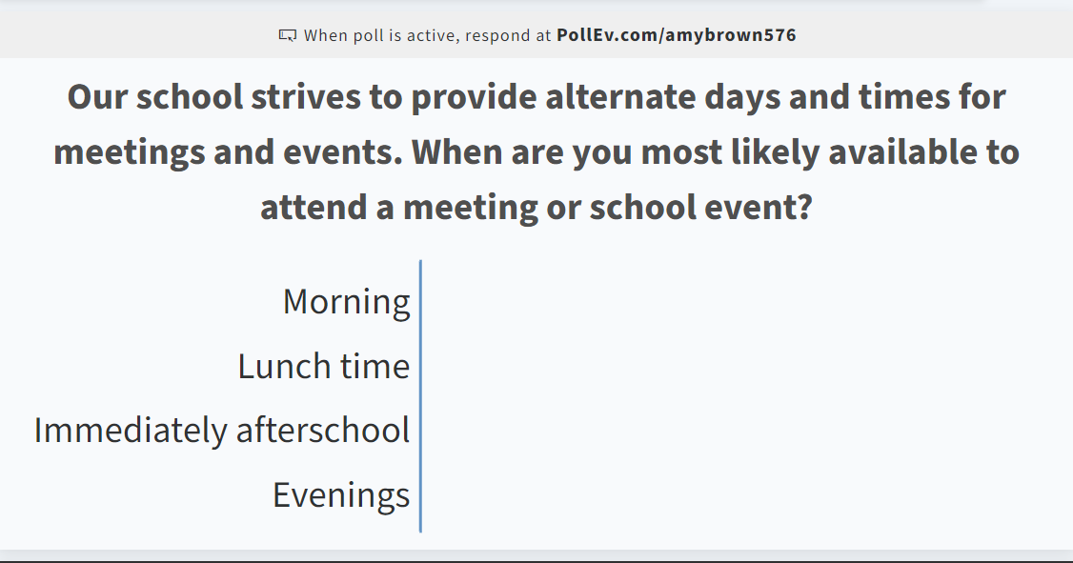
Opportunity for Two Way Communication
As mentioned in the previous slide, the PFEP ensures to provide families with flexible meeting times.
Engagement Tip!
Conduct a quick poll to find out what times work best for your families.
*Check out polleverywhere.com*
Notes:
Evidence – please keep this as evidence to support using feedback to inform flexible meetings.

Slide 21
Parent Advisory Council (PAC)
The District has a Parent and Family Engagement Plan. The summary of the plan is in the Title I School & Family Partnership Overview.
You may access the full plan at www.pcsb.org/titleone
The Parent Advisory Council (PAC) is responsible for reviewing and revising the District PFEP.
PAC will meet virtually or in-person with the district’s Title I staff.
Each school is committed to having at least one member representative on PAC.
PAC meets twice a year, if you are interested in representing our school please notify, Insert contact person
Notes:
Please add your PAC representative in slide and share with your Title I Specialist.

Slide 22
Recruitment Video: We Want you !
Parent Advisory Council (PAC) Video
Notes:
Please play the 1-minute video to share with families about the PAC and the interest form (which is on the next slide).

Slide 23
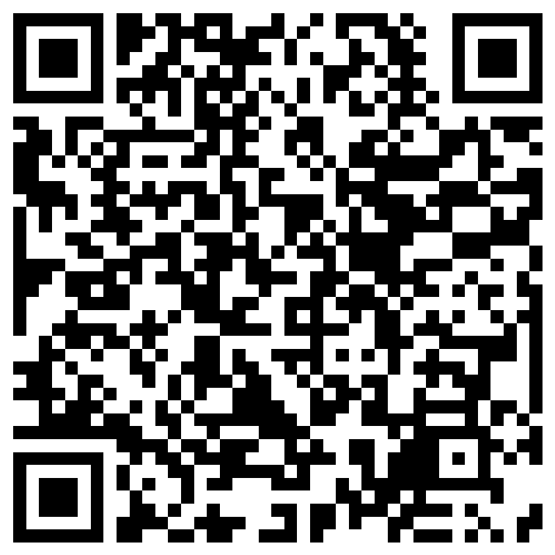
Parent Advisory Council (PAC) Interest Form
Notes:
Please complete the form if you are interested in representing your school/community.
Please allow a minute for interested families to complete the form during the meeting.
Here is the link for you to share also: https://forms.office.com/r/XYv54tECMy

Slide 24

Accountability
  School Report Cards
  School Grade and Overview
  Population and Enrollment
  Assessments – Academic Achievement, Growth, and Population
  Assessments – English Language Learners
  Graduation and Beyond
  Educator Qualifications and Equity
  Long-Term Goals and Interim Progress
  Accelerated Course Enrollment
  Per-Pupil Expenditures
  National Data
  Available online at https://edudata.fldoe.org/ or Front Office

Slide 25


Shift to New B.E.S.T. Standards
Notes:
All curriculum, instruction and assessments are based on student-centered expectations.
FSA → Transition to BEST!
https://www.flgov.com/2021/09/14/governor-desantis-announces-end-of-the-high-stakes-fsa-testing-to-become-the-first-state-in-the-nation-to-fully-transition-to-progress-monitoring/

Slide 26


Florida Benchmark For Excellent Student Thinking Standards (B.E.S.T). You may read more information by visiting, http://www.fldoe.org/standardsreview/
Notes:
All curriculum, instruction and assessments are based on student-centered expectations.

Slide 27

New Assessment: FAST
More information can be found about the FSA Transition to FAST:
https://feaweb.org/fsa-transition-to-fast/
Source: https://www.flgov.com/2021/09/14/governor-desantis-announces-end-of-the-high-stakes-fsa-testing-to-become-the-first-state-in-the-nation-to-fully-transition-to-progress-monitoring/

Slide 28
Florida End of Course (EOC)
Assessments
(Algebra 1, Biology, Civics, U.S. History, Geometry)
Add EOC information
To learn more about state assessments visit the Florida Department of Education’s website, fldoe.org/accountability/assessments.
Notes:
This slide is only required, if it truly applies.

Slide 29

School’s Curriculum
Florida Benchmark For Excellent Student Thinking Standards (B.E.S.T). form the framework of everything taught at school.
Core Curriculum (insert specifics)
  Reading
  Mathematics
  Writing
  Science
  Civics
Notes:
This slide is optional if this will be discussed with classroom teacher
School’s Curriculum
Describe and explain the curriculum (Specific names of texts)

Slide 30

Working Together for Student Success
Please join us…
Insert upcoming Parent and Family Events, SAC meetings, Parent Academy Webinars….
Notes:
Do you have a calendar of key events that are included in your PFEP.
Evidence – Consider this as evidence to include to support Family Engagement.

Slide 31
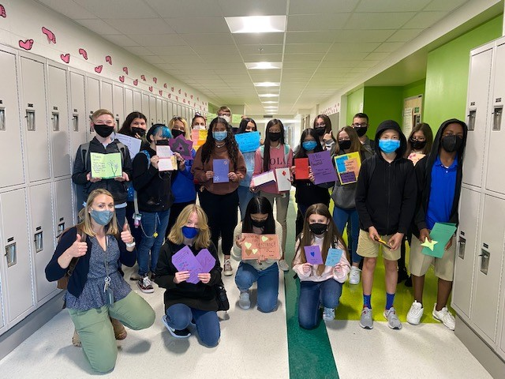

Additional Resources
Learning at Home Family Resources - https://www.pcsb.org/Page/32836
Volunteer in a Pinellas County School - https://www.pcsb.org/Page/459
Parent Academy POWER HOURS Webinars - https://www.pcsb.org/Page/26534
Partnerships - https://www.pcsb.org/Page/418

Slide 32
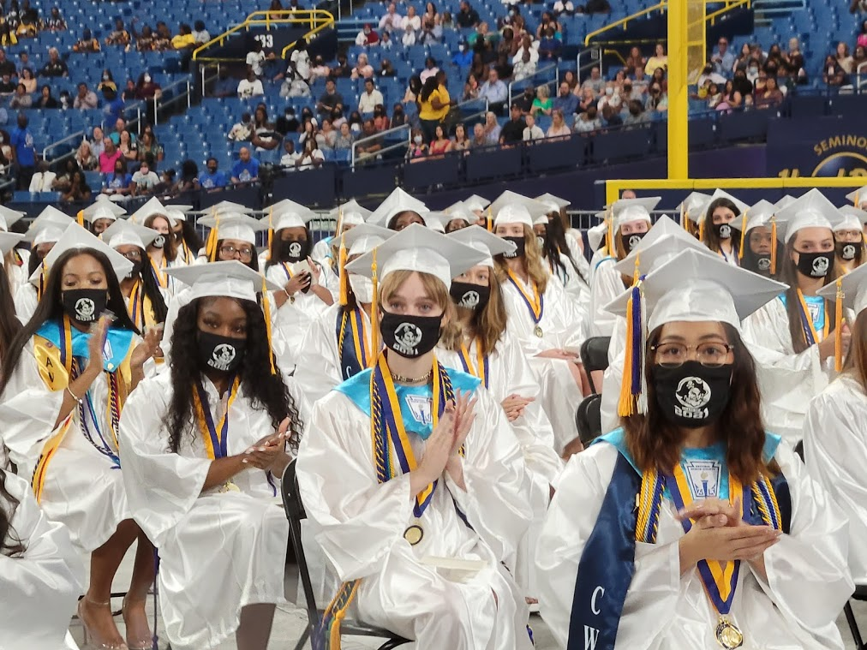
We appreciate your time!
Please feel free to ask any questions and provide feedback on our Title I Program.

Slide 33
Contact Us
Street Address
City, State, Zip code
Phone
Email
Insert school photo here or logo

Slide 34
Education is for improving the lives of others and for leaving your community and world better than you found it.
Marian Wright Edelman

Slide 35
Please take the time to participate in our survey.
Scan the QR Code below
See notes for details.
Your feedback is greatly appreciated!
Notes:
Please duplicate Microsoft Forms provided or create school survey. To generate a QR code hover over your school’s survey and and right click. Create QR code for this page will be an option.
https://forms.office.com/Pages/ShareFormPage.aspx?id=BZM8c9c5GkaGb_3ye_PH_x-1YNVO6C1FkgA88U6PR2tUNEQzTU0wNkZXVUxVTlpEMU81NkJFMlJNTi4u&sharetoken=FXXhmgwFjSnl0sNz61ki

Slide 36
Opportunity for Two Way Communication
Engagement Tip!
Share the next steps (both immediate and long term) that you and your school team will make based on the feedback that you received during this meeting.
Notes:
Delete this slide prior to your meeting;
Edit the questions so that they are getting meaningful data….
Things to follow up on…
Here is a sample survey that you can use to make your own:
*Microsoft Forms link – all you have to duplicate the survey, then you can revise and add (or take out) information pertaining to your specific school site.
https://forms.office.com/Pages/ShareFormPage.aspx?id=BZM8c9c5GkaGb_3ye_PH_4y9PDKtKHtGmxkIUFGx54tUQ0dRTTlSSURDNkJHWTMyUEhUQUpXQk1OUy4u&sharetoken=poJKcDEDaKhuAKNAwi0x
Based on the feedback from the form, we will use the information to provide meetings during times that work for you. Address some of the academic challenges, and bring additional resources to support parenting.

Slide 37
SlidesCarnival icons are editable shapes.
This means that you can:
Resize them without losing quality.
Change fill color and opacity.
Change line color, width and style.
Isn’t that nice? :)
Examples:
Find more icons at slidescarnival.com/extra-free-resources-icons-and-maps

Slide 38
Diagrams and infographics

